Slide 1
How to use BERT?
Department of Electrical Engineering
I-Shou University
The second year of the PhD degree
Chen Chien-Hua
2020/10/16

Slide 2
Transform words to numbers
Reclassification
BOW (bag-of-words)
TF-IDF (term frequency–inverse document frequency)
Topic modeling:
Latent Semantic Analysis(LSA)
Latent Dirichlet Allocation(LDA)
Word embedding (Word2vec)
Paragraph vector (Doc2Vec)

Slide 3
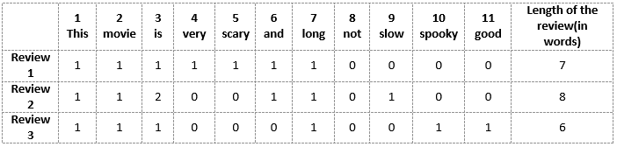
BOW
Review 1: This movie is very scary and long
Review 2: This movie is not scary and is slow
Review 3: This movie is spooky and good

Slide 4

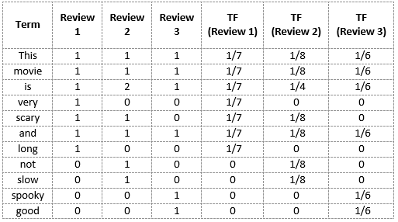
Term Frequency (TF)

Slide 5

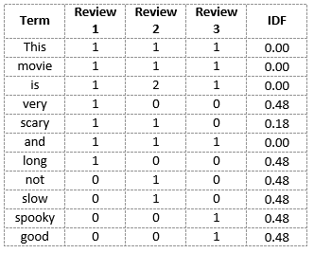
Inverse Document Frequency (IDF)

Slide 6
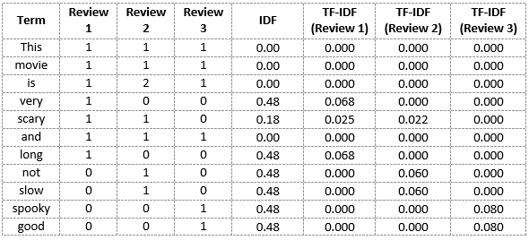
BOW vs. TF-IDF

Slide 7
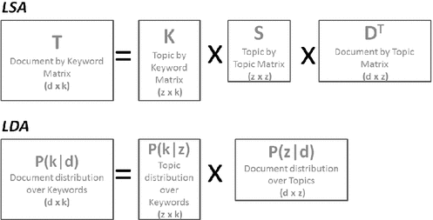
LSA vs. LDA

Slide 8
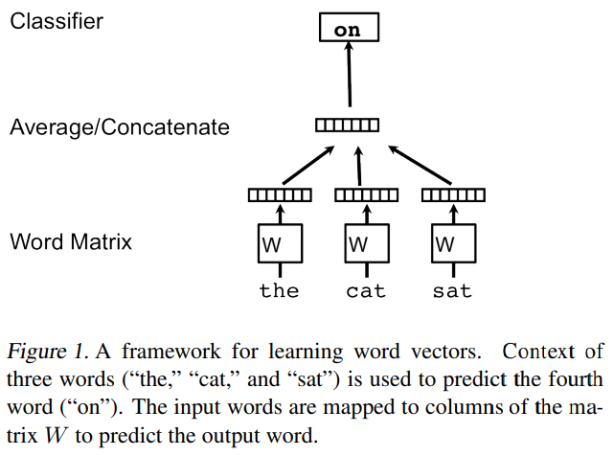
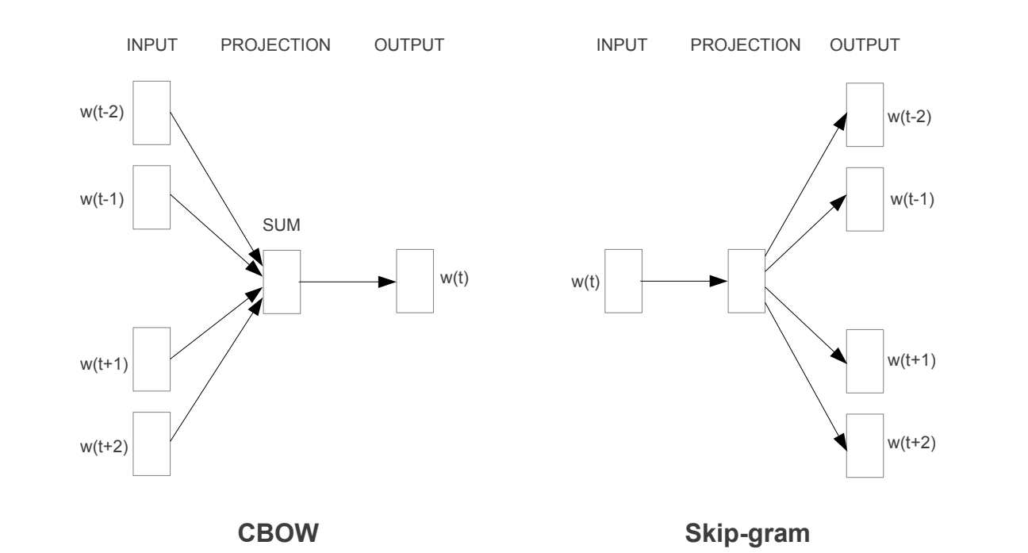
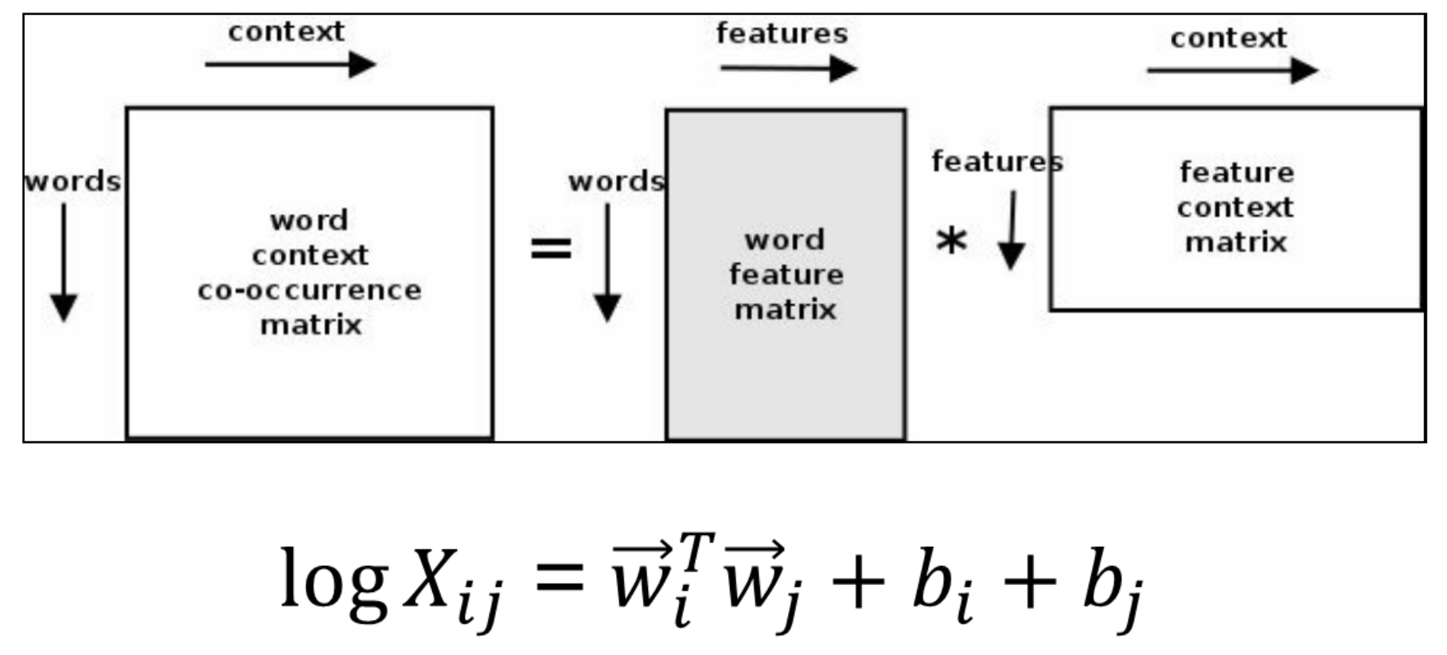
Word embedding
gensim.models.word2vec
Word2vec
Skip-gram
CBOW
FastText
GloVe
WordRank
GloVe

Slide 9
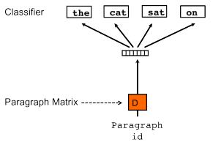
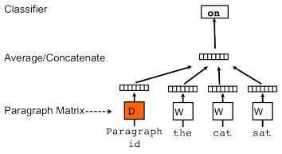
Paragraph vector
gensim.models.doc2vec
Distributed Memory
Distributed Bag of Words
Distributed Representations of Sentences and Documents
https://arxiv.org/abs/1405.4053

Slide 10
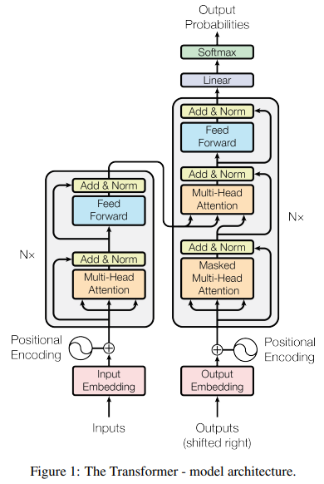
Transformer
Attention Is All You Need
https://arxiv.org/abs/1706.03762

Slide 11
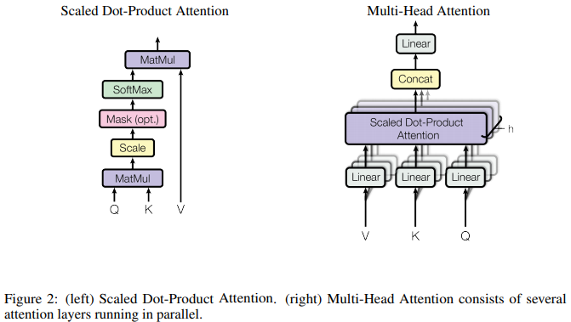
Attention
Attention Is All You Need
https://arxiv.org/abs/1706.03762

Slide 12
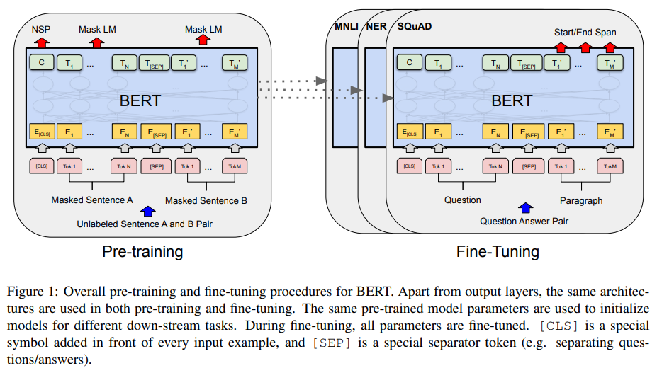
BERT Bidirectional Encoder Representations from Transformers
Google AI Language
BERT: Pre-training of Deep Bidirectional Transformers for Language Understanding
https://arxiv.org/abs/1810.04805

Slide 13
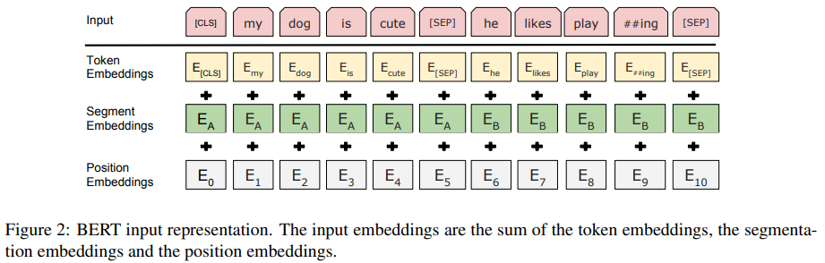
BERT input representation
BERT: Pre-training of Deep Bidirectional Transformers for Language Understanding
https://arxiv.org/abs/1810.04805

Slide 14
Pre-training BERT
Task #1: Masked LM (language model)
Task #2: Next Sentence Prediction (NSP)
Pre-training data
BooksCorpus (800M words) (Zhu et al., 2015)
English Wikipedia (2,500M words)
Two model sizes:
BERTBASE (L=12, H=768, A=12, Total Parameters=110M)
BERTLARGE (L=24, H=1024, A=16, Total Parameters=340M)
BERT: Pre-training of Deep Bidirectional Transformers for Language Understanding
https://arxiv.org/abs/1810.04805

Slide 15
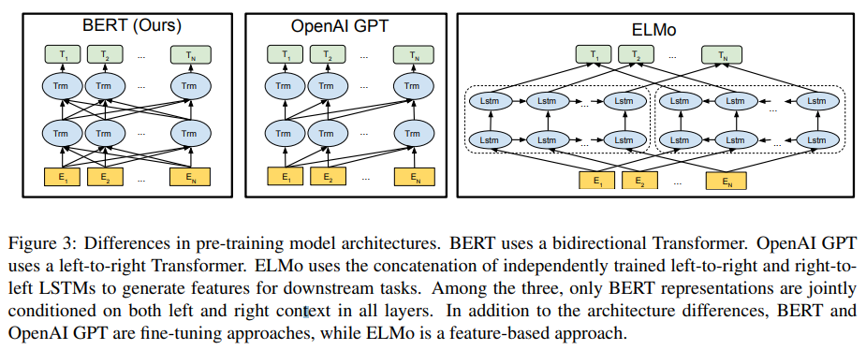
Differences in pre-training model architectures
BERT: Pre-training of Deep Bidirectional Transformers for Language Understanding
https://arxiv.org/abs/1810.04805

Slide 16
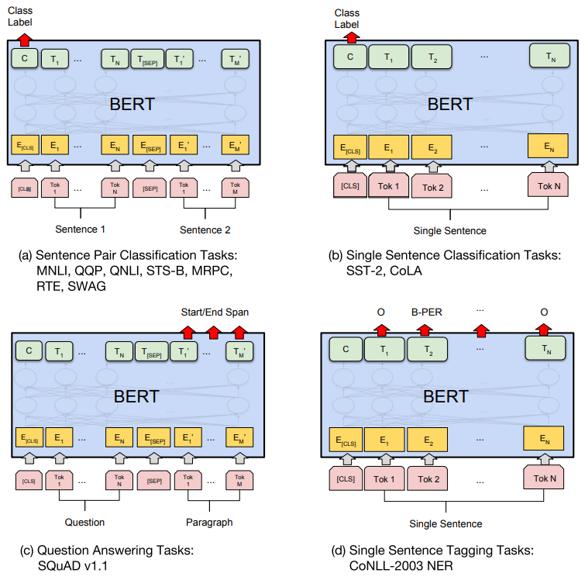
Fine-tuning BERT on Different Tasks
BERT: Pre-training of Deep Bidirectional Transformers for Language Understanding
https://arxiv.org/abs/1810.04805

Slide 17
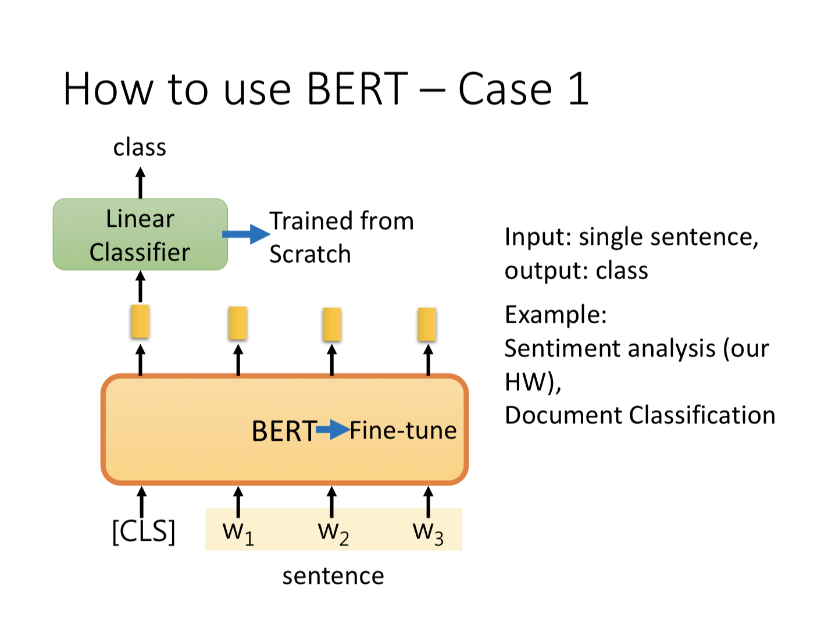
https://www.youtube.com/watch?v=UYPa347-DdE

Slide 18
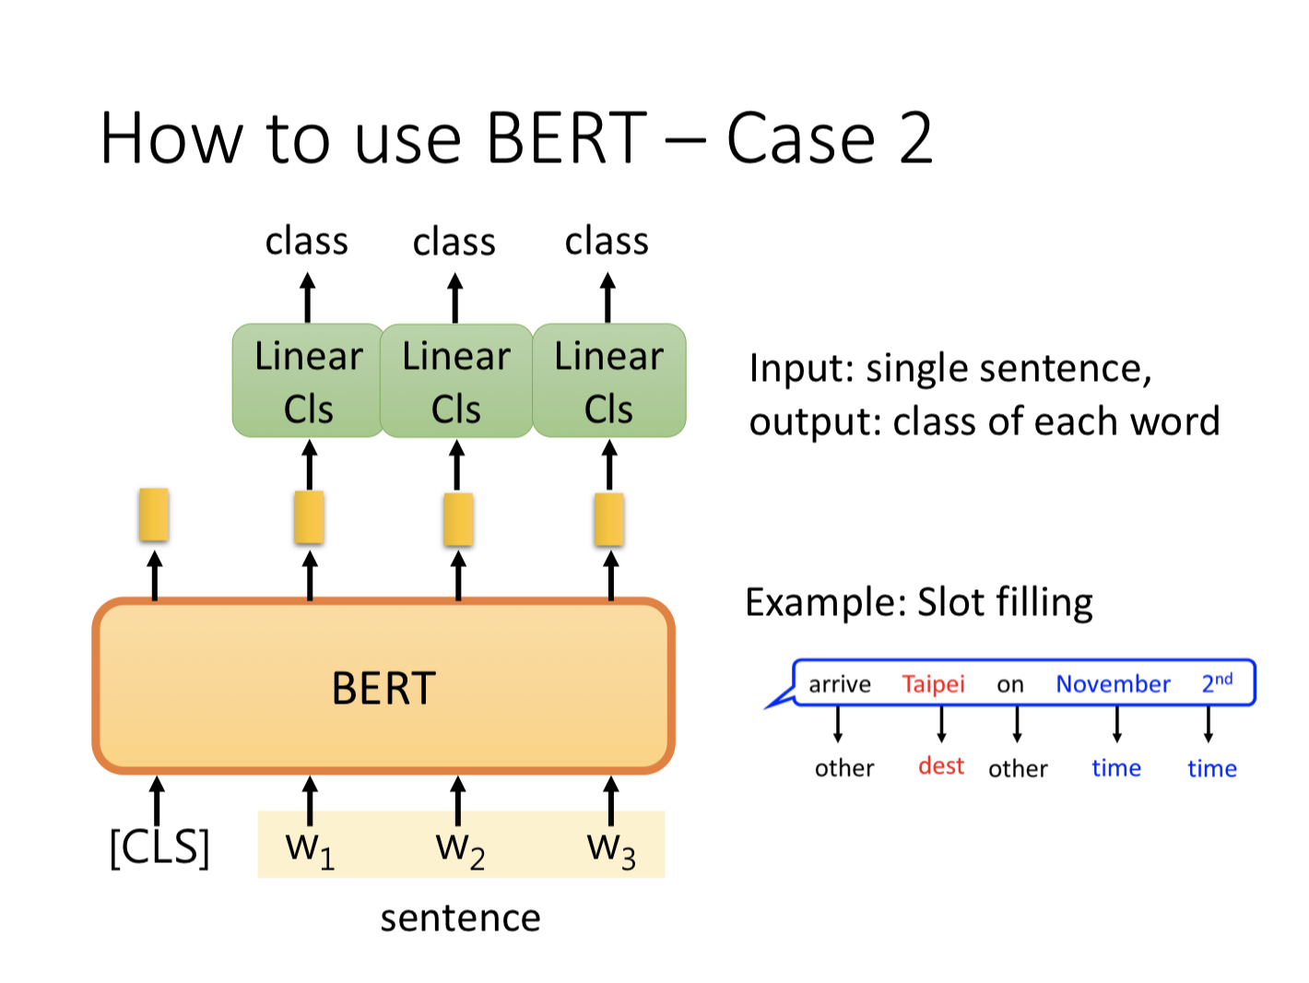
https://www.youtube.com/watch?v=UYPa347-DdE

Slide 19
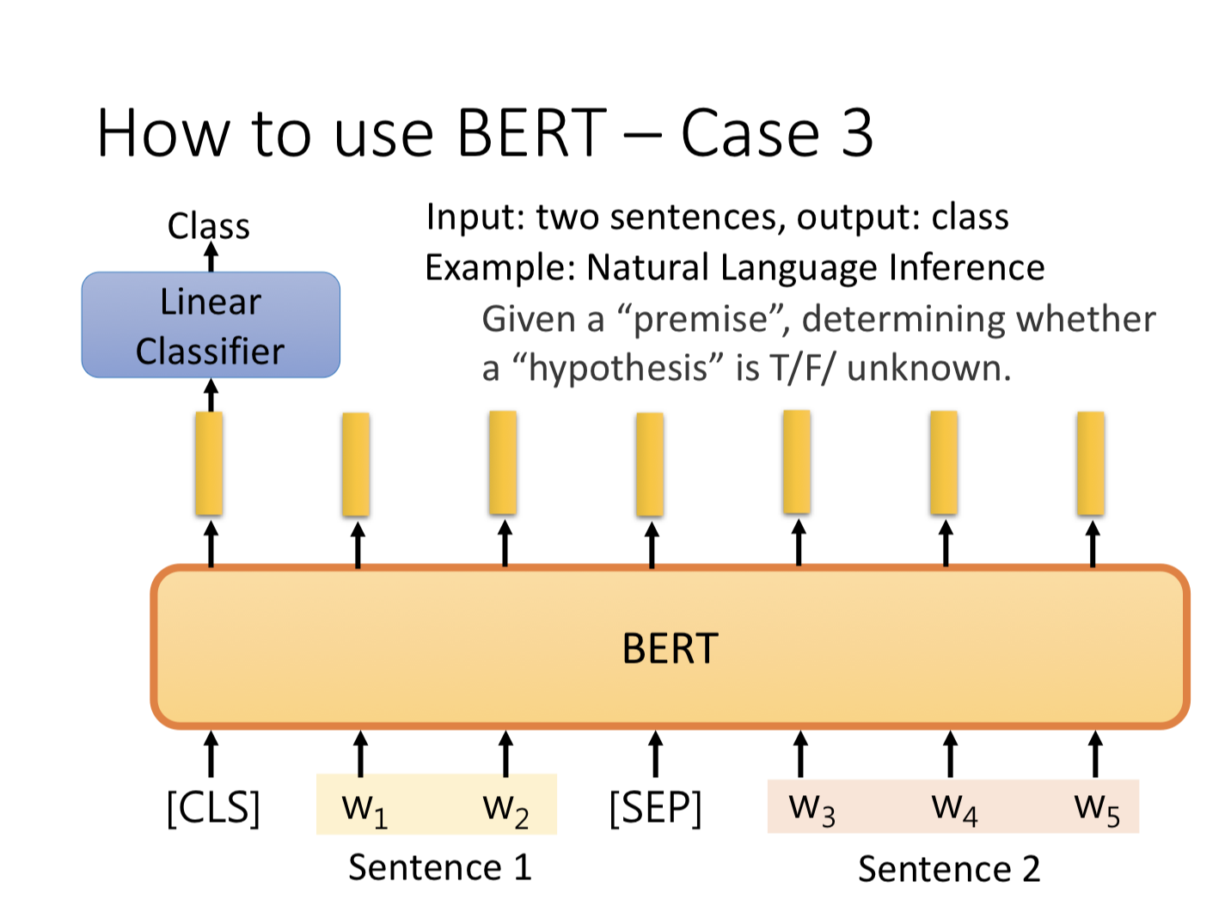
https://www.youtube.com/watch?v=UYPa347-DdE

Slide 20
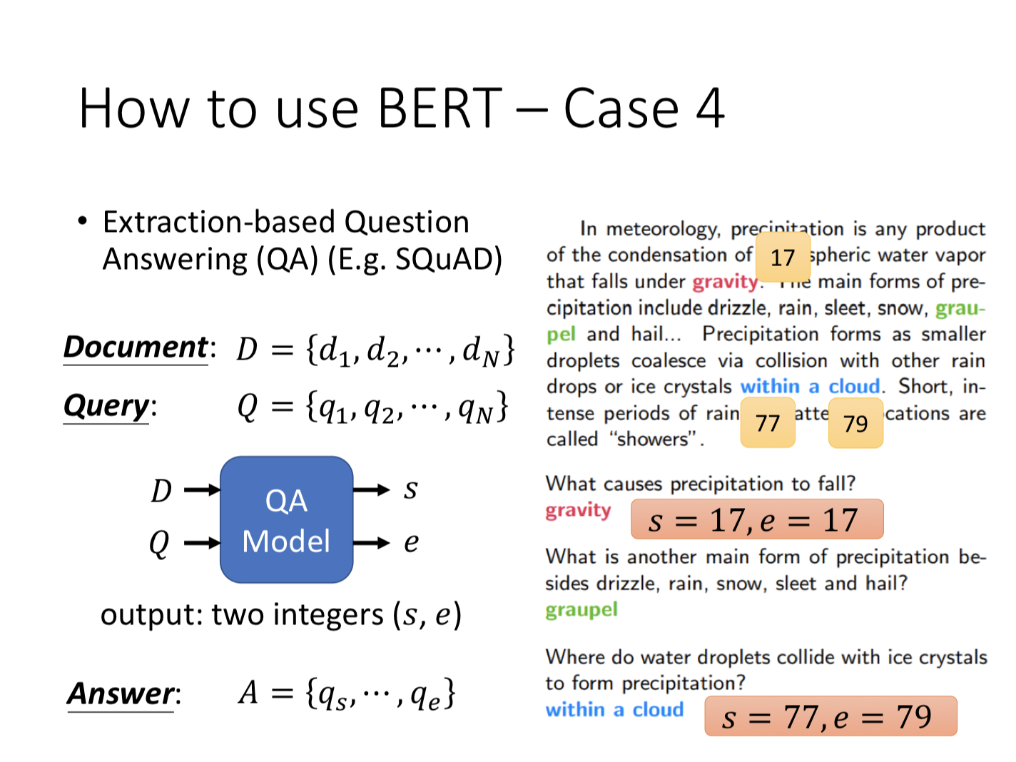
https://www.youtube.com/watch?v=UYPa347-DdE

Slide 21
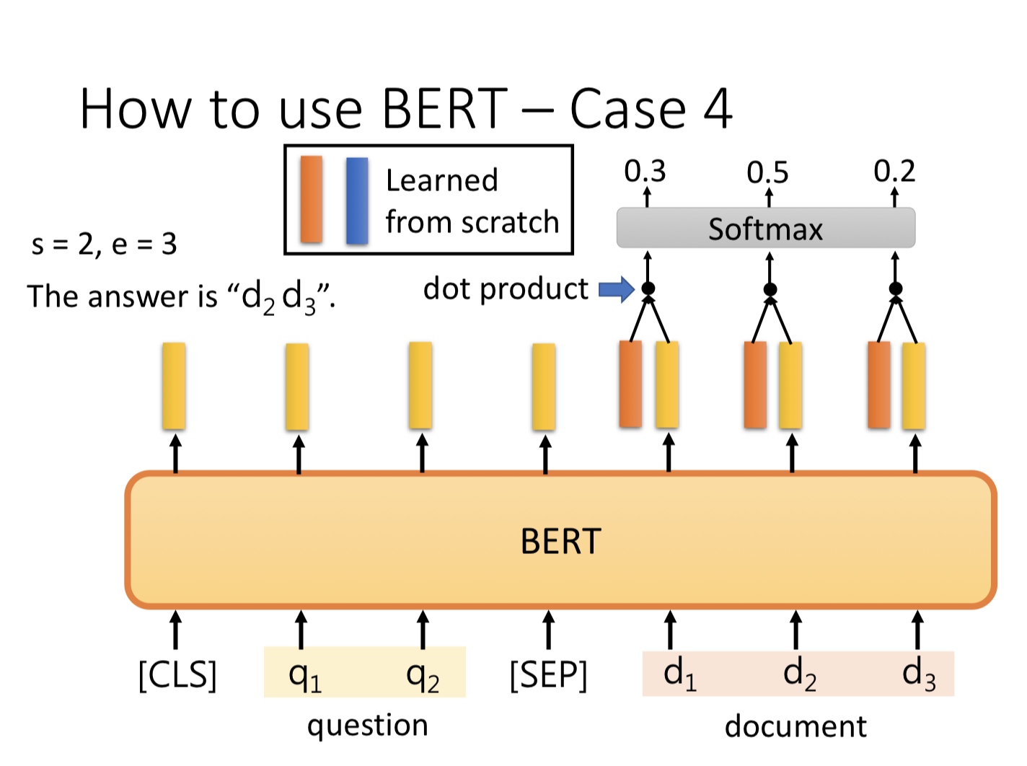
https://www.youtube.com/watch?v=UYPa347-DdE

Slide 22

How to use BERT?
https://github.com/chienhuachen/BERT

